Slide 1
Comparative Analysis of Machine Learning Algorithms for
Heart Disease Prediction
Anirudh Pal Kaushik(2210991268)
Supervised By
Dr Gurpreet Singh
Department of Computer Science and Engineering,
Chitkara University, Punjab

Slide 2
Table of Contents
• Abstract
• Problem Statement
• Key Features
• Technical details
• Literature Review
• Implementation
• Results/Outputs
• Future Scope
2

Slide 3
Abstract
Heart disease is one of the leading causes of death worldwide, and early prediction of this disease is of prime importance to improve healthcare services and reduce mortality rates. This paper proposes a system to predict heart disease using various machine learning algorithms. A healthcare dataset is considered to predict heart disease using classification algorithms such as Logistic Regression, K-Nearest Neighbors (KNN), and Random Forest.
The models are tested based on accuracy, precision, and recall, and Logistic Regression is found to have a high accuracy of 95%, making it a better model compared to others. This proposed system is helpful in taking quick and accurate decisions to reduce heart disease and improve healthcare services.
3

Slide 4
It is one of the major causes of death worldwide. Early detection of heart disease is a complex issue since it depends on various health parameters. Detection of heart disease has been done traditionally based on the expertise of a medical professional. However, such an approach may not always yield highly accurate results, particularly when dealing with complex data sets.
The problem statement here is to design an efficient machine learning-based system to predict whether a person suffers from heart disease or not based on given data. This problem statement also includes comparing algorithms to achieve a more accurate model based on performance metrics. This helps in improving the accuracy of predictions, which in turn helps in reducing mortality rates.
Problem Statement
4

Slide 5


Key Features & Functionalities
It utilizes machine learning for heart disease prediction.
It includes multiple algorithms for heart disease prediction, such as Logistic Regression, KNN, and Random Forest.
It includes data preprocessing steps such as data cleaning, normalization, and removing outliers.
It includes feature selection and dimensionality reduction for better performance.
It includes the evaluation of the model by utilizing accuracy, precision, recall, and F1-score.
It includes comparative analysis for multiple algorithms.
It aids in the early detection of heart disease
It aims to reduce the mortality rate and improve healthcare services

Slide 6
Technical Architectural
Data Collection Layer: Heart disease dataset collected from sources like Kaggle, containing health parameters of patients.
Data Preprocessing Layer: Data cleaning, handling missing data, removing outliers, normalization, and feature selection.
Data Splitting: Dataset split into training and testing sets, with 80% for training and 20% for testing using the hold-out method.
Model Building Layer: Implementation of machine learning algorithms like Logistic Regression, KNN, Random Forest.
Training & Testing Layer: Implementation of machine learning algorithms to train and test the model.
Evaluation Layer: Evaluation of the model using metrics like accuracy, precision, recall, and F1 score.
Prediction Layer: Implementation of the final model, which is Logistic Regression to predict whether the patient has heart disease or not.
Output Layer: Result displayed to help doctors in decision-making.

Slide 7
Literature Review
Several studies have been conducted to improve the prediction of heart disease by utilizing machine learning algorithms. Purushottam et al. were one of the researchers who used Decision Tree algorithms to predict heart disease. This study showed an accuracy of about 86.7%. This proved the efficiency of data mining algorithms in healthcare. Santana Krishnan J. et al. conducted another study in which Decision Tree algorithms were compared with Naive Bayes. Decision Tree algorithms were found more efficient in terms of accuracy, which was 91%. This proved the significance of choosing algorithms in data mining.
Further studies were conducted on more efficient algorithms such as Multilayer Perceptron (MLP) and K-Nearest Neighbors (KNN) to increase the accuracy of results. Senthil Kumar Mohan et al. conducted a study in which Random Forest and linear algorithms were used. This study showed an accuracy of about 88.7%. This proved the efficiency of machine learning algorithms in improving the accuracy of results compared to traditional algorithms.
7

Slide 8
Implementation
The implementation of the proposed system involves collecting a heart disease dataset containing various medical attributes. The dataset is then preprocessed to remove missing values and outliers. It also includes normalization to improve the performance of the system. Various feature selection and dimension reduction methods are also employed to identify the most important attributes.
Once the dataset is preprocessed, the proposed system implements the hold-out method to divide the dataset into training and testing datasets. The dataset is divided in the ratio 80:20 for training and testing, respectively. Various machine learning algorithms such as Logistic Regression, K-Nearest Neighbors, and Random Forest are implemented and executed on the dataset. The performance of the system is measured by evaluating the accuracy, precision, recall, and F1-score. The proposed system then selects the best model, which in this case is Logistic Regression, to make predictions regarding heart disease, thus facilitating faster and accurate decisions.

Slide 9
Results / Output
The performance of implemented machine learning algorithms was measured based on performance metrics such as accuracy, precision, recall, and F1-score. Among the implemented algorithms, such as Logistic Regression, KNN, and Random Forest, Logistic Regression showed a maximum accuracy of 95%, making it a more efficient algorithm compared to others in heart disease prediction. KNN showed a relatively low accuracy compared to Logistic Regression, which proves that Logistic Regression can be more suitable for this dataset.
The output of the system will be a prediction based on whether a patient suffers from heart disease (1) or not (0). Moreover, the output will be based on a confusion matrix, which shows whether the classification was correct or incorrect. This proves that the proposed system can accurately predict heart disease, which helps healthcare professionals take faster and more efficient decisions.

Slide 10
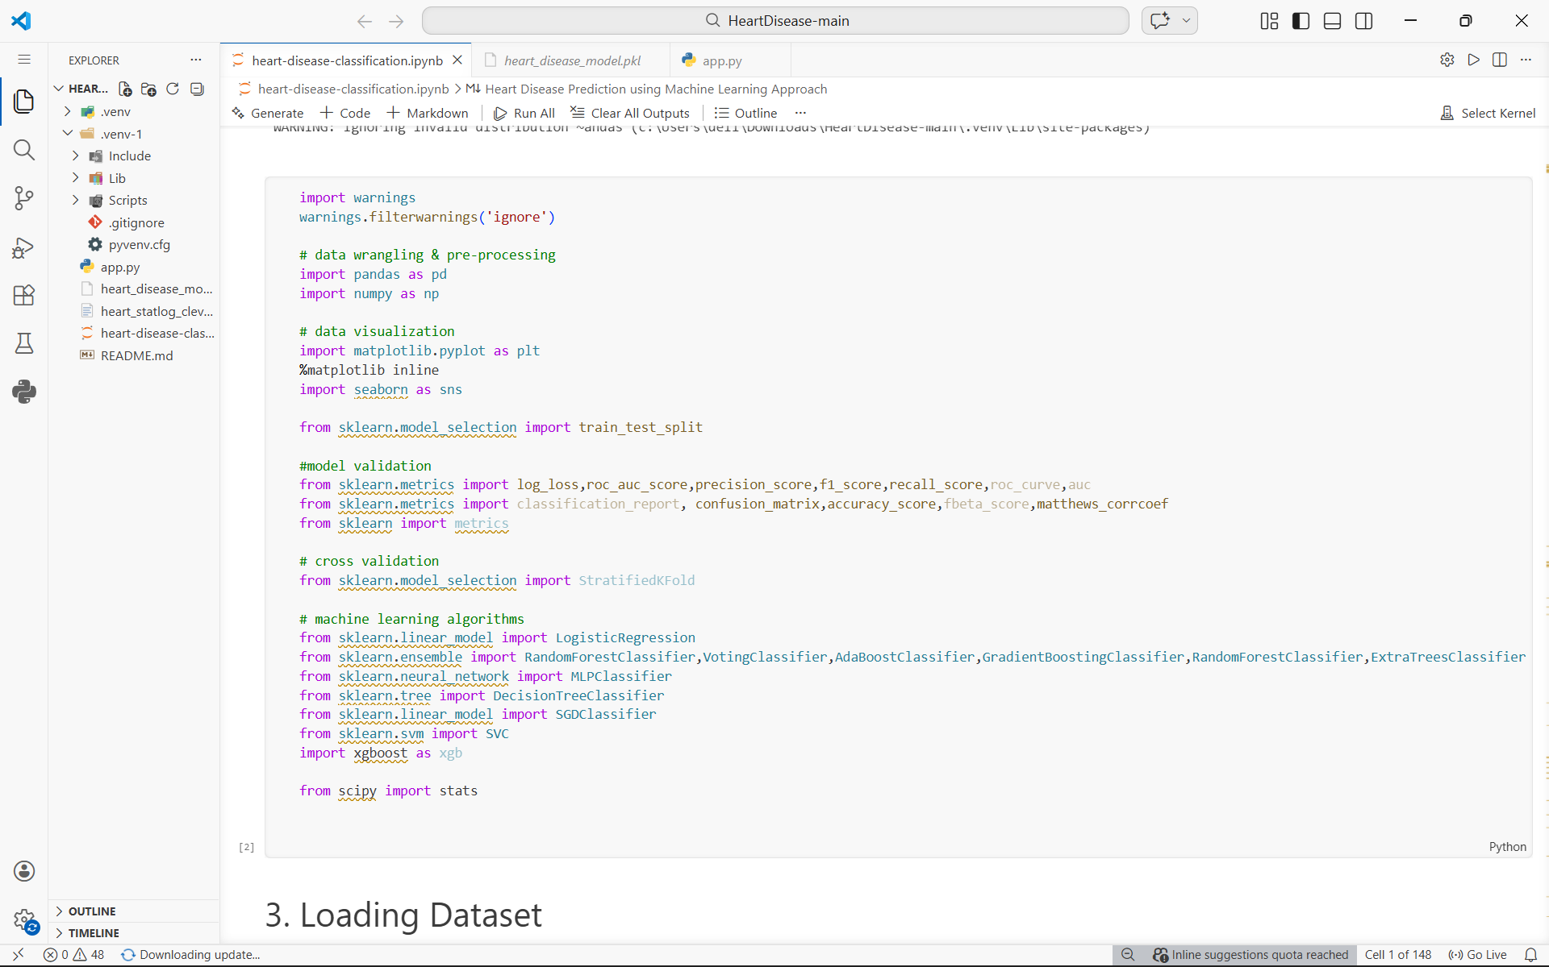
Code Snippet

Slide 11
Future Scope
Use larger and more diverse datasets to improve accuracy and generalization
Apply advanced techniques like deep learning and neural networks
Develop hybrid models to enhance prediction performance
Integrate the system with real-time healthcare systems
Connect with IoT devices and wearable health trackers
Enable real-time monitoring and prediction of patient health
Include more medical parameters for better analysis
Improve model generalization and reduce overfitting
Support better clinical decision-making and help reduce mortality rates

Slide 12
References
Purushottam Sharma et al., Efficient Heart Disease Prediction System using Decision Tree: Study of Cleveland Dataset.
Santana Krishnan J et al., Heart Disease Prediction using Decision Tree and Naive Bayes.
Sonam Nikhar et al., Comparative Study of Naive Bayes and Decision Tree Classifiers.
Aditi Gavhane et al., Heart Disease Prediction using Multilayer Perceptron (MLP).
Avinash Golande et al., Data Mining Techniques for Heart Disease Diagnosis.
Senthil Kumar Mohan et al., Prediction of Heart Disease using Random Forest and Linear Models.
Anjan N Repaka et al., Machine Learning Models for Heart Disease Prediction.
Kaggle, Heart Disease Dataset for Machine Learning.

Slide 13
Thank You
13

